Slide 1
The Power of Choice in Data-Aware Cluster Scheduling
Shivaram Venkataraman¹ , Aurojit Panda¹ Ganesh Ananthanarayanan², Michael Franklin¹, Ion Stoica¹
¹UC Berkeley, ²Microsoft Research
Present by Qi Wang Borrow some slides from the author

Slide 2
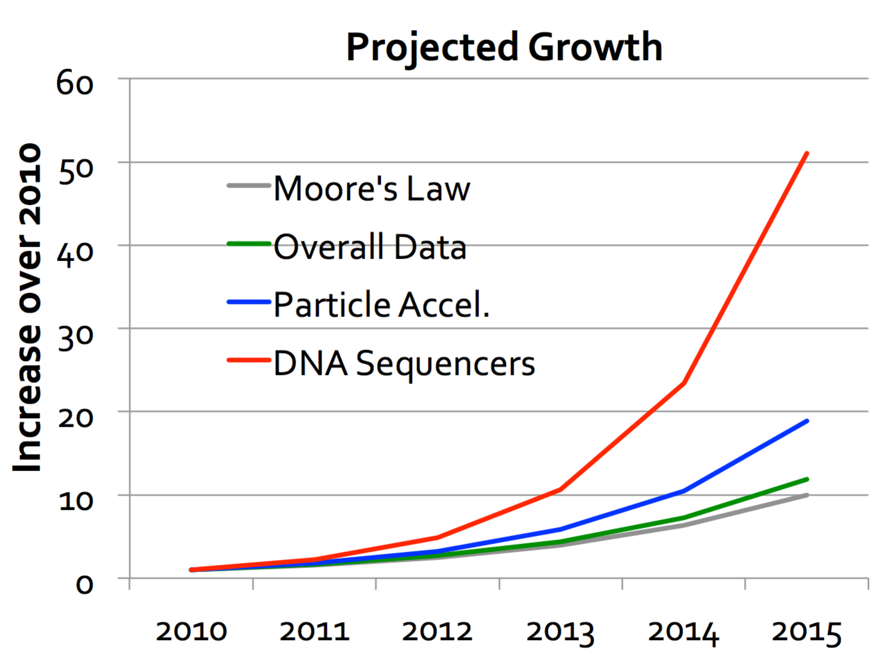
Trends: Big Data
Data grows faster than Moore’s Law!
[Kathy Yelick LBNL, VLDBJ 2012, Dhruba Borthakur]

Slide 3




Trends: Low Latency
10 min
1 min
10s
2s
2004:
MapReduce
batch job
2009:
Hive
2010:
Dremel
2012:
In-memory
Spark

Slide 4


Big Data or Low Latency
SQL
Query
:
2.5
TB
on
100
machines
?
< 10s
> 15 minutes
1 - 5
Minutes

Slide 5
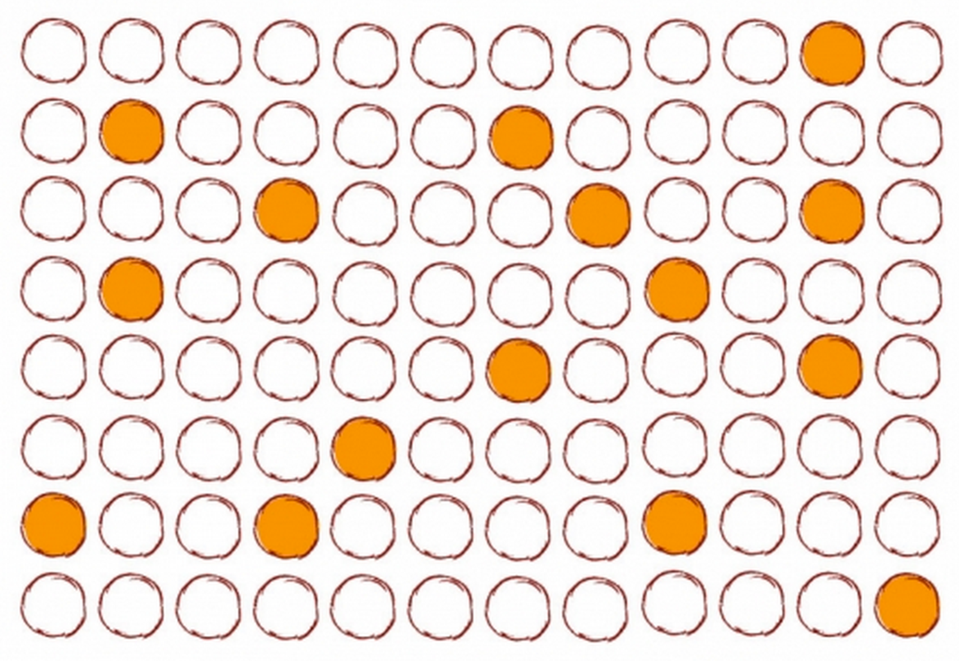
Trends: Sampling
Use a subset of the input data

Slide 6
Applications
Approximate Query Processing
blinkdb
presto
minitable
Machine learning algorithms
stochastic gradient
coordinate descent
Notes:
A key property of such jobs is that they can compute on any of the combinatorially many subsets of the in- put dataset without compromising application correct- ness.

Slide 7


Combinatorial Choices
N
Any K
Sampling -> Smaller inputs + Choice

Slide 8








Existing scheduler
Available (N) = 2
Required (K) = 2
1
2
Rack
3
4
Time
Available Data
Running
Busy
Unavailable Data
11

Slide 9





Choice-aware scheduler
Available (N) = 4
Required (K) = 2
1
2
Rack
3
4
Time
Available Data
Running
Busy

Slide 10
Data-aware scheduling
Input stage
Less than 60% of tasks achieve locality even with three replica
Tasks have to be scheduled with memory locality
Intermediate stages
The runtime is dictated by the amount of data transferred across racks
To schedule the task at a machine that minimizes the time it takes to transfer all remote inputs

Slide 11
Cross-rack skew
Core
Bottleneck Link
Link with Max. transfers
2 2
4 2
6
4
Cross Rack Data Skew
M₄
R₂
M₅
R₃
M₁
M₂
Maximum
Minimum
transfers
transfers
M₃
R₁
6
2
=
= 3

Slide 12


KMN Scheduler
A scheduling framework
Exploits the available choices to improve performance
Choose the subset of data dynamically
increase locality for input
Stages
balance network usage for
intermediate stages
Input Stage
Intermediate Stage

Slide 13
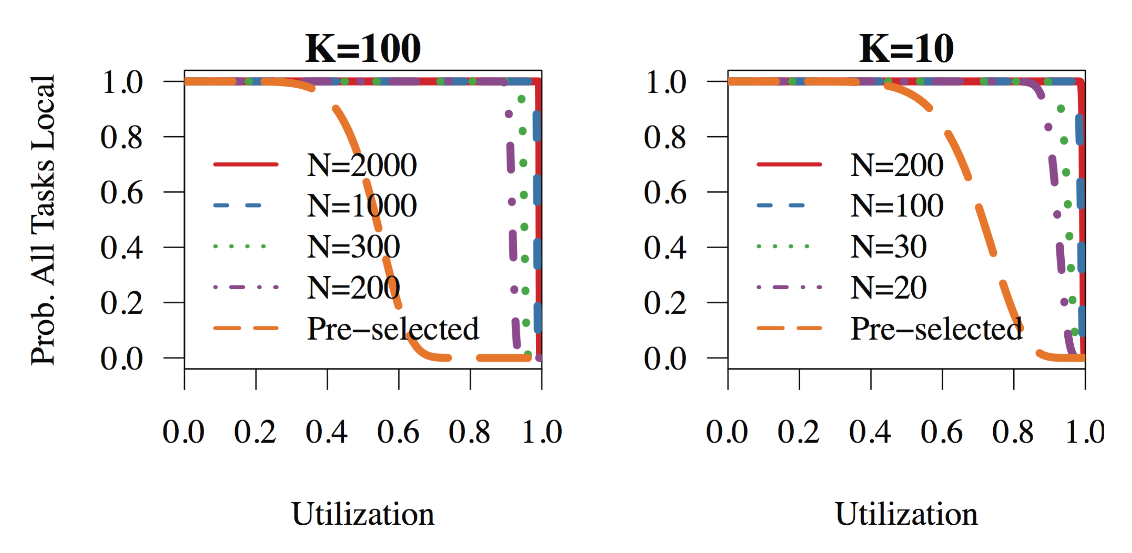
Input stage
Jobs which can use any K of the N input blocks
Notes:
Tasks read data from distributed storage
Main idea: leverage the combinatorial choice of inputs

Slide 14
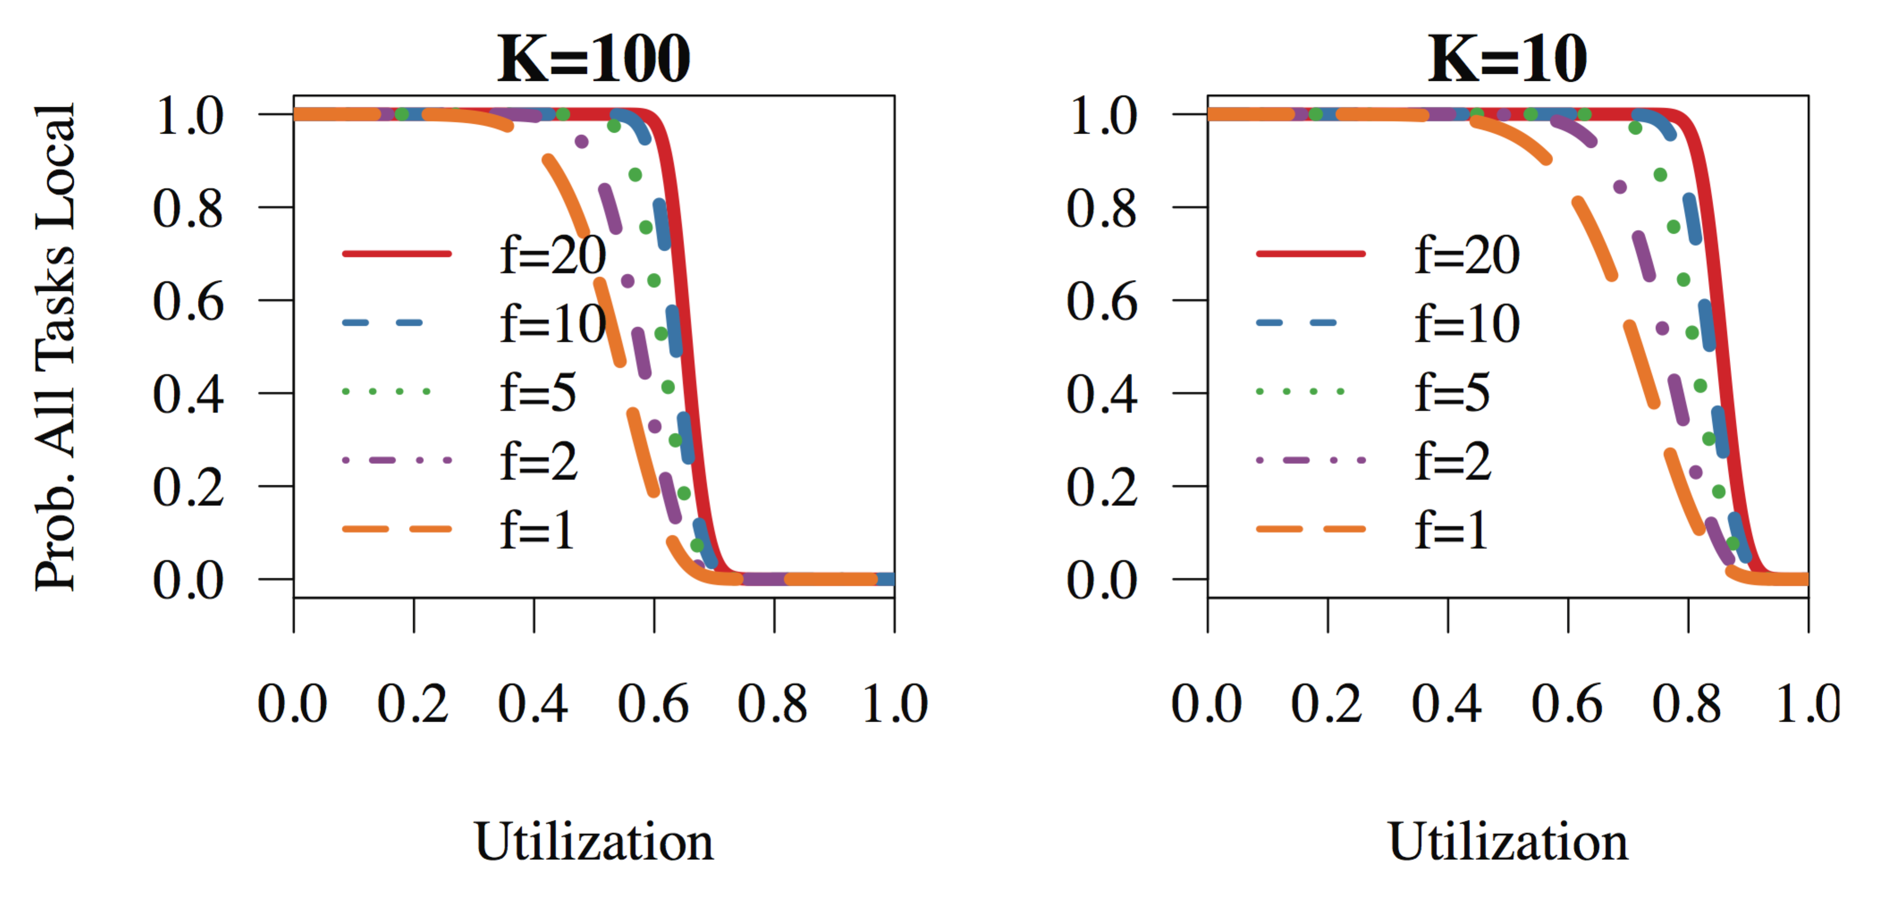
Input stage
Jobs which use a custom sampling functions

Slide 15
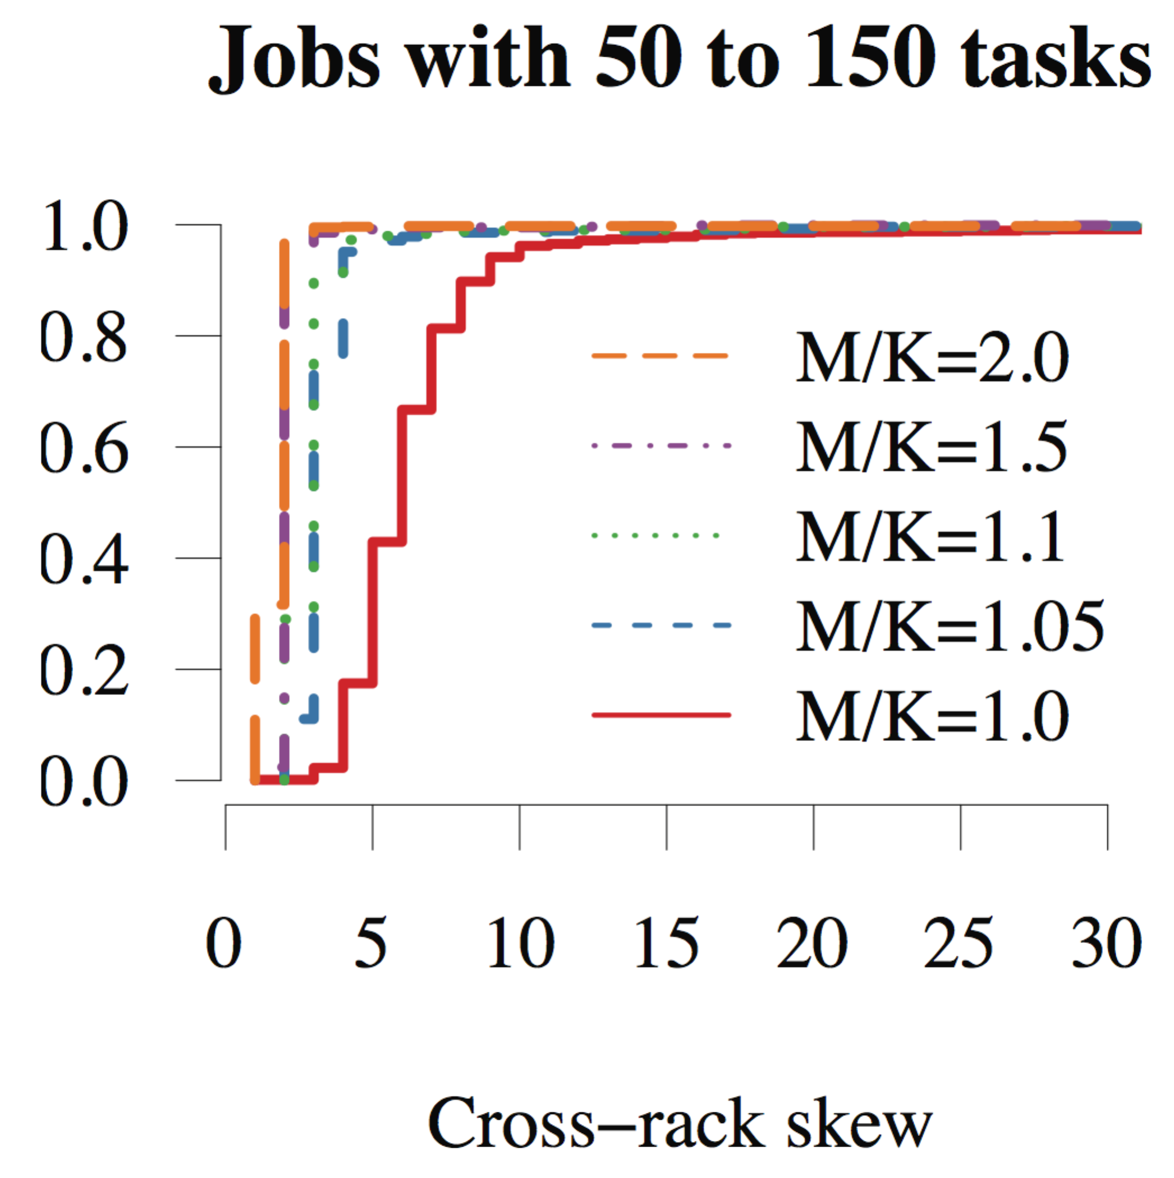
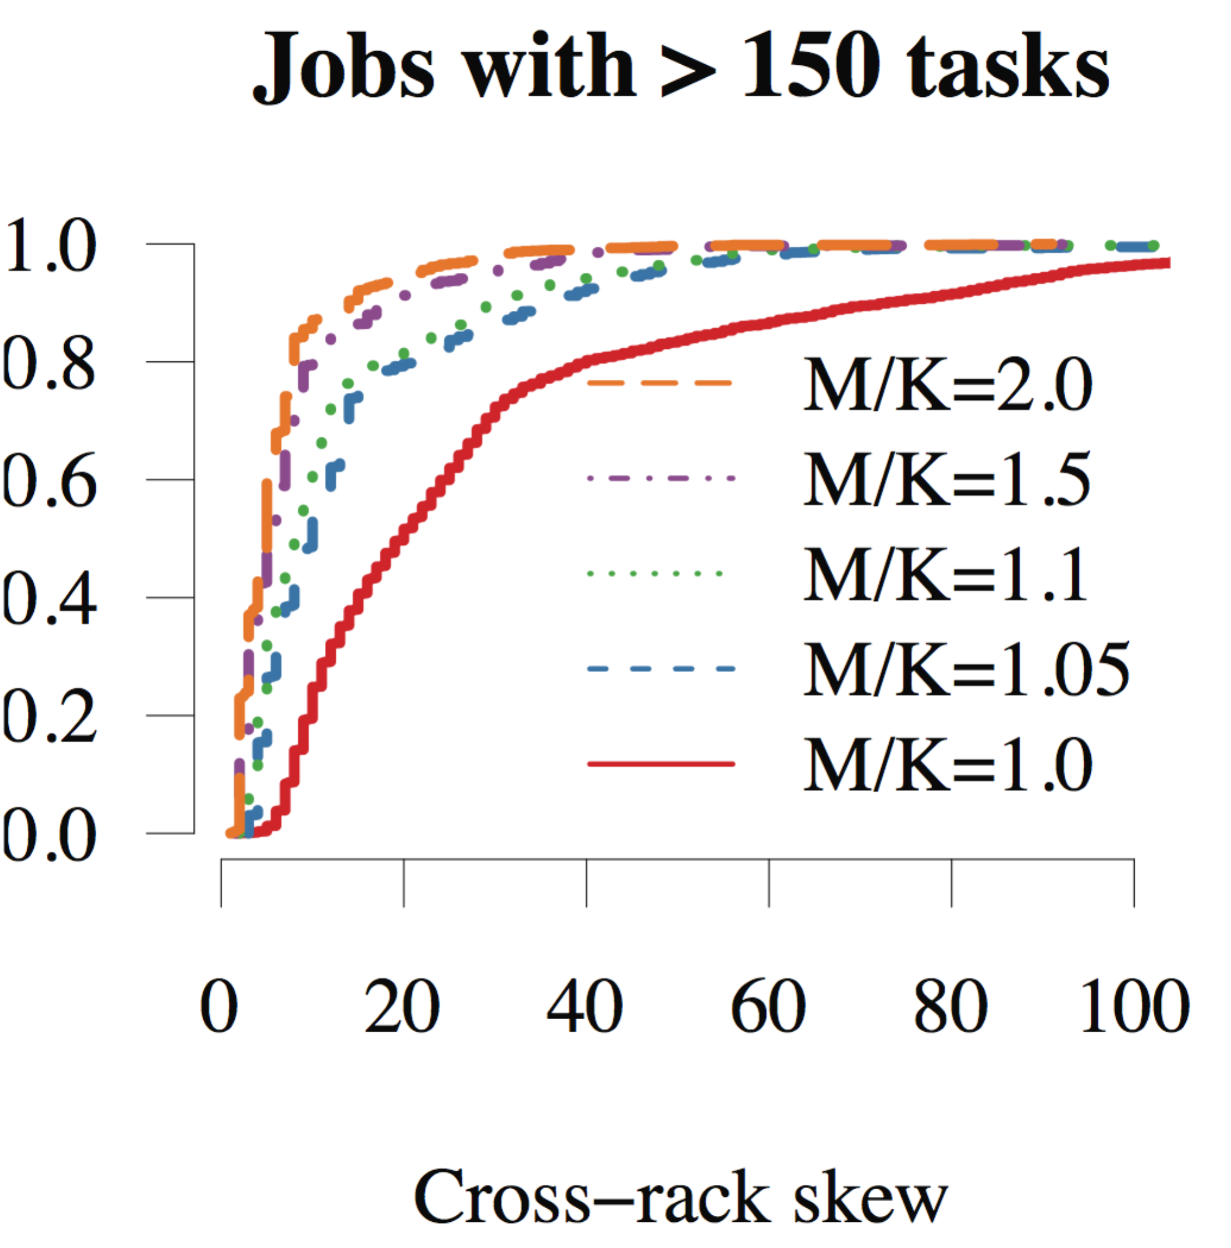
Intermediate stage
Challenges
Main idea
Scheduling a few additional tasks at upstream stage
Schedule M tasks for an upstream stage with K tasks
Notes:
They consume all the outputs produced by upstream tasks. Thus, they have no choice in picking their inputs.
We see that running a few extra tasks is an effective strategy to reduce skew.

Slide 16


Schedule additional tasks
Available (N) = 4
Launched (M) = 3
Required (K) = 2
1
2
Rack
3
4
Time
Available Data
Running
Busy

Slide 17





Select best upstream outputs
Round-robin strategy
Spread choice of K outputs across as many racks as possible
M
M
M
M
M
K
= 5
cross-rack skew
= 3

Slide 18


Select best upstream outputs
After running extra tasks
M
M
M
M M
M M
M = 7
K = 5
cross-rack skew
= 3

Slide 19






Select best upstream outputs
M
M
M
M M
M M
M = 7
K = 5
cross-rack skew
= 2

Slide 20
Handling Stragglers
Wait all M can be inefficient due to stragglers
Balance between waiting and losing choice
A delay-based approach
Bounding transfer
Whenever the delay D_{K’} is greater than the maximum improvement, we can stop the search as the succeeding delays will increase the total time
Coalescing tasks
Coalesce a number of task finish events to further reduce the search space
Notes:
Our solution for this problem is to schedule downstream tasks at some point after K upstream tasks have completed but not wait for the stragglers in the M tasks
balances the gains in balanced network transfers against the time spent waiting for stragglers.
We use job sizes to figure out if the same job has been run before. Based on this we use the job history to predict the task finish times.

Slide 21
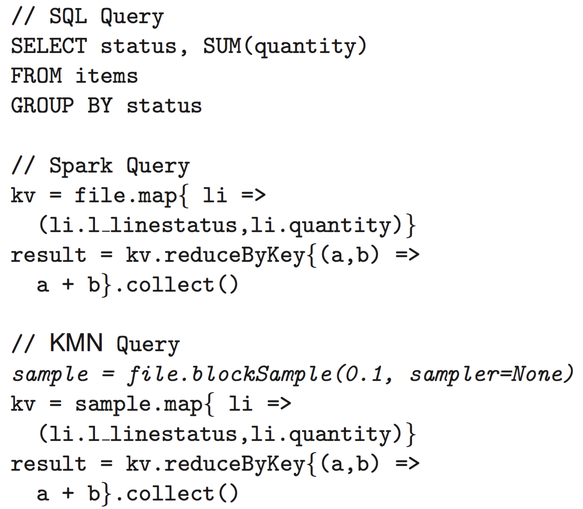
Using KMN
KMN is built on top of Spark

Slide 22
Evaluation
Cluster Setup
100 m2.4xlarge EC2 machines, 68GB RAM/mc
Baseline
Using existing schedulers with pre-selected samples
Metrics
% improvement = (baseline time – KMN time)/baseline time

Slide 23
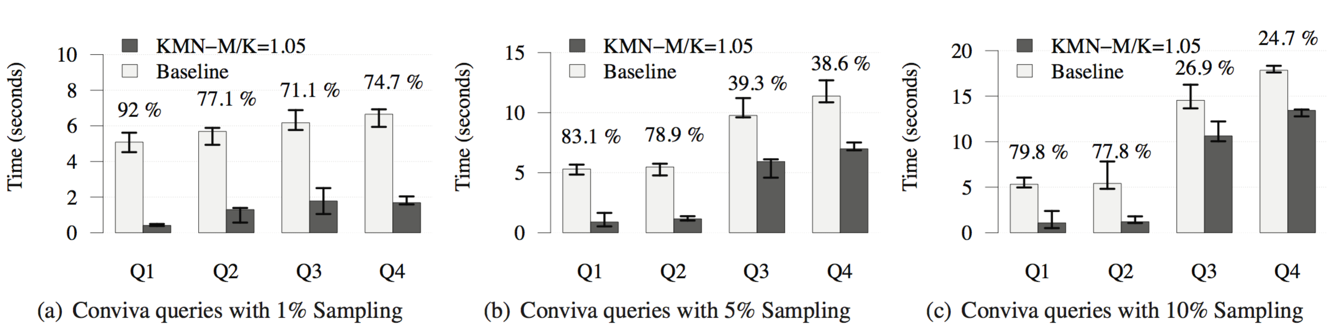
Conviva Sampling jobs
Running 4 real-world sampling queries obtained from Conviva

Slide 24

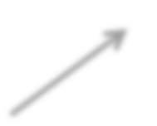

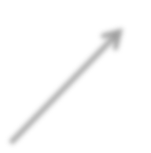

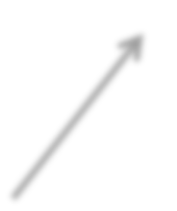
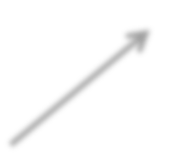

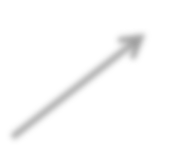
Machine learning workload
Stochastic Gradient Descent
Aggregate3
Aggregate2
Aggregate1
Gradient
Notes:
SGD is an iterative method that scales to large datasets and is widely used in applications such as machine translation and image classification.
We run SGD on a dataset contain- ing 2 million data items, where each each item contains 4000 features. The complete dataset is around 64GB in size and each of our iterations operates on a 1% sample 1% of the data.

Slide 25
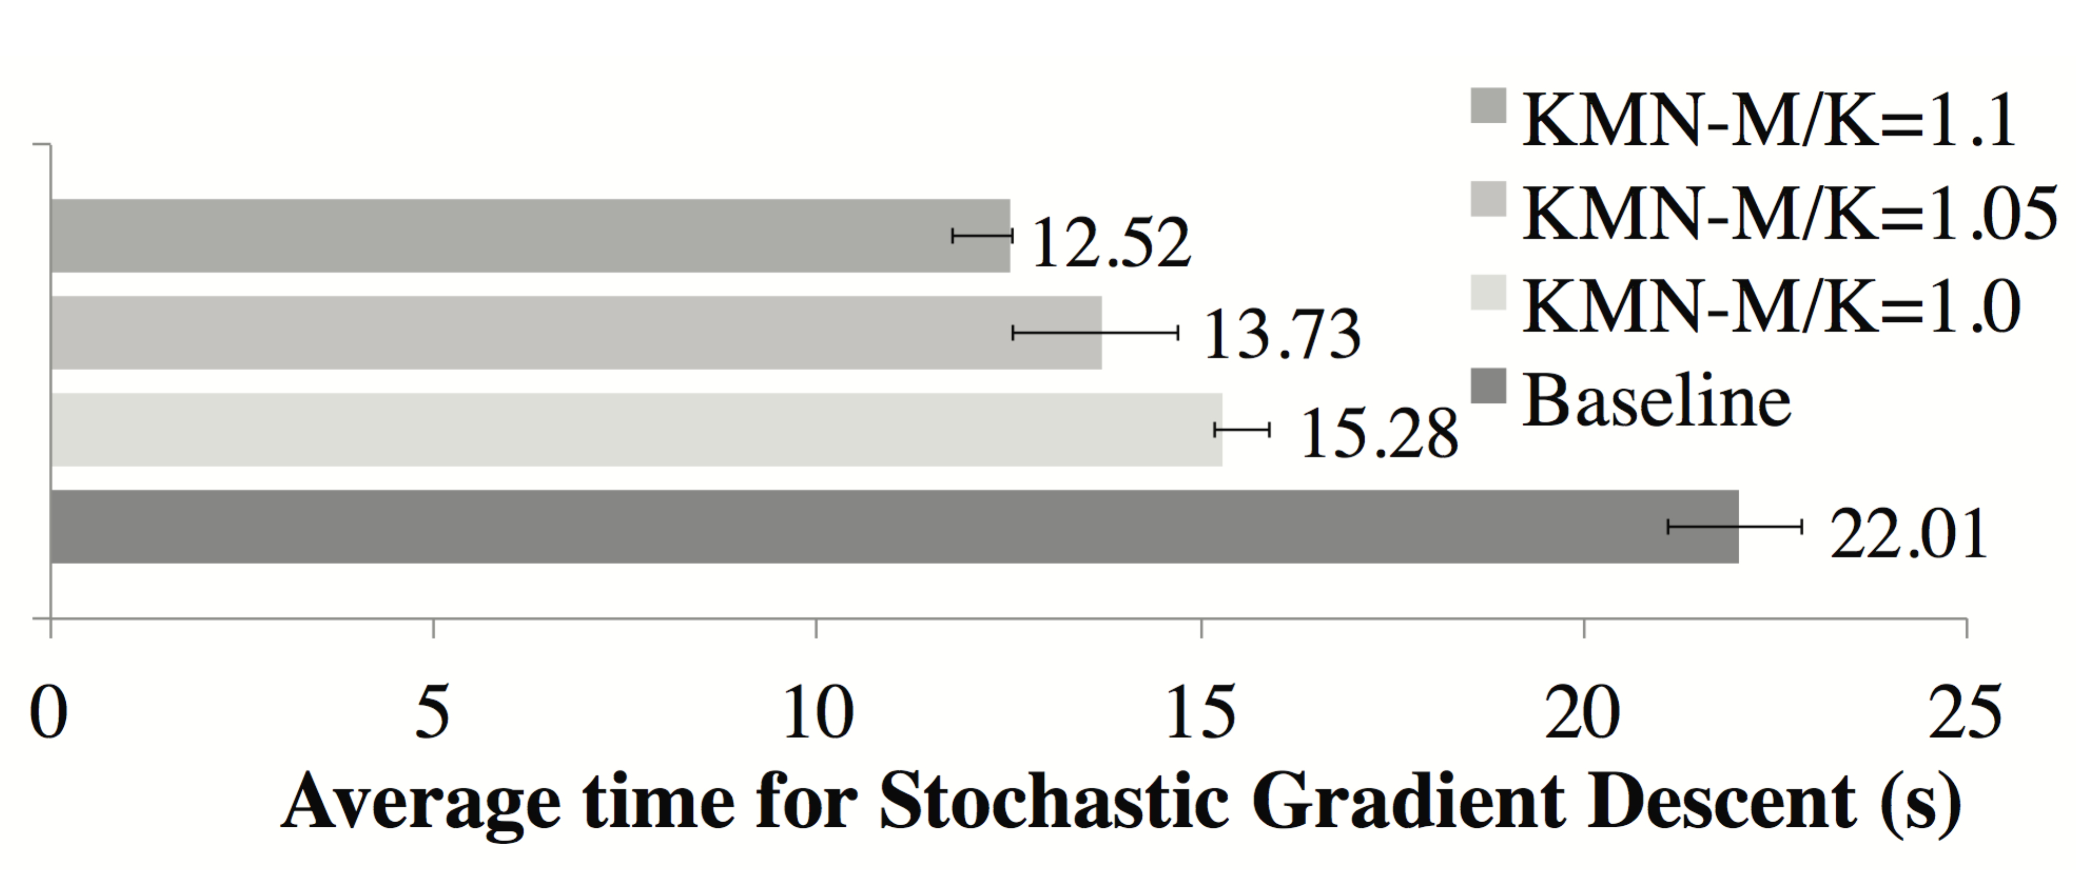
Machine learning workload
Overall benefits
Notes:
KMN-M/K = 1.1 improves performance by 43% as compared to the baseline.

Slide 26
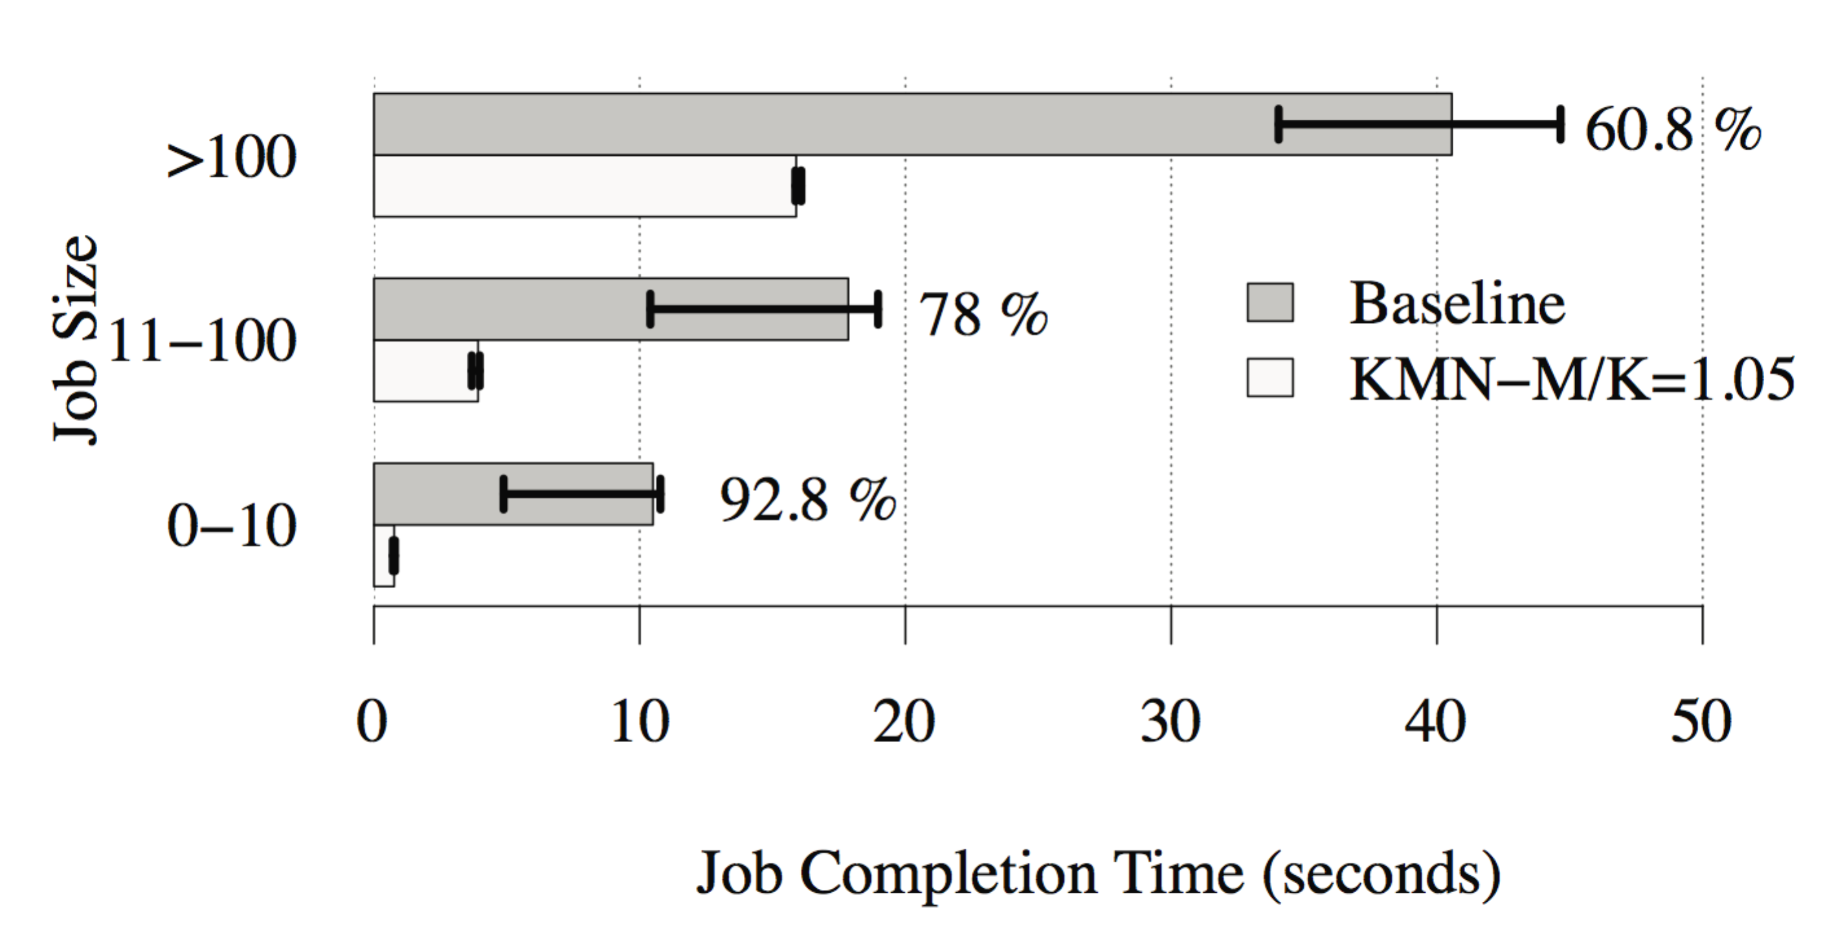
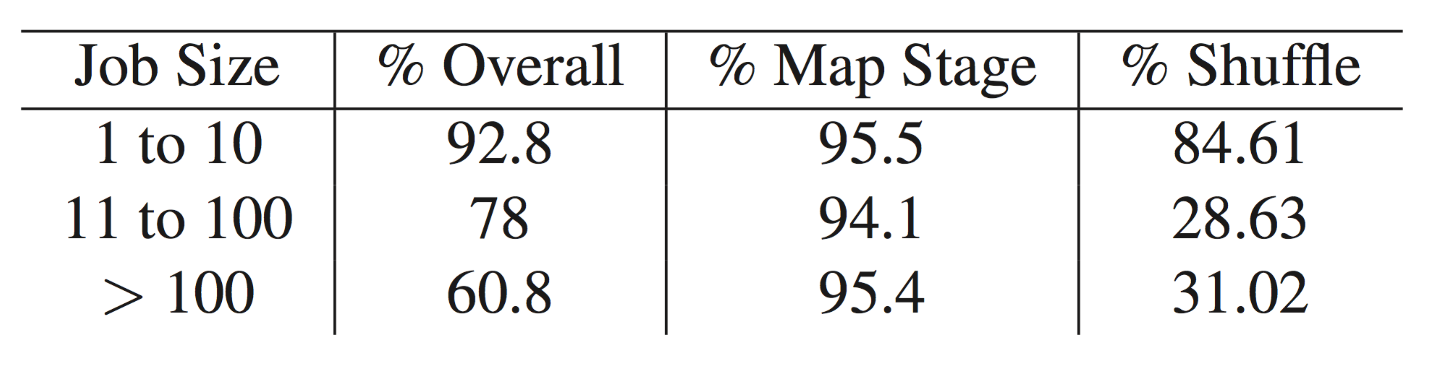
Facebook workload
Notes:
Workload trace from Facebook Hadoop cluster

Slide 27
Conclusion
Application trends
Operate on subsets of data
KMN
Exploit the available choices to improve performance
Increasing locality
balancing intermediate data transfers
Reduce average job duration by 80% using just 5% additional resources

Slide 28
Cons
Reduce the randomness of the selection
Extra resources are used
The utilization spikes also are not taken into account by the model and jobs which arrive during a spike do not get locality
Need to modify threads
Not helpful for small jobs
No benefits for longer stages
Not general to other applications
……

Slide 29
Questions
Is round-robin the best heuristic that can be used here?
What is the recommended value for extra upstream tasks? In evaluation part, authors tested with 0%, 5%, and 10%, but they did not discuss the optimal value for the extra portion of upstream tasks.
How would the system scale with the number of stages in the computation?
Notes:
Since KMN expect “a few” extra jobs at each stage, would this number grows too big with the number of stages? The paper does not discuss how failures of jobs would impact the overall performance of KMN. Do they restart failed jobs, or do they simply rely on redundancy of jobs?

Slide 30
Thank you!

Slide 31

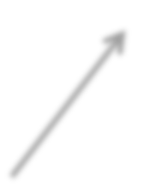
Gradient
KMN Stages
Time (s)
Gradient
15.27
Aggregate3
Aggregate2
Aggregate1

Slide 32
Aggregate1
Gradient
KMN Stages
Time (s)
Gradient
15.27
Aggregate3
Gradient + Agg1
12.72
Aggregate2

Slide 33
Aggregate2
Aggregate1
Gradient
KMN Stages
Time (s)
Gradient
15.27
Aggregate3
Gradient + Agg1
12.72
Gradient + Agg2
11.79

Slide 34
Aggregate3
Aggregate2
Aggregate1
Gradient
KMN Stages
Time (s)
Gradient
15.27
Gradient + Agg1
12.72
Gradient + Agg2
11.79
Gradient + Agg3
12.09

